Slide 1
The seals hamurinn
English version of Selshamurinn
1. and 2. classes in Sjálandsskóli

Slide 2
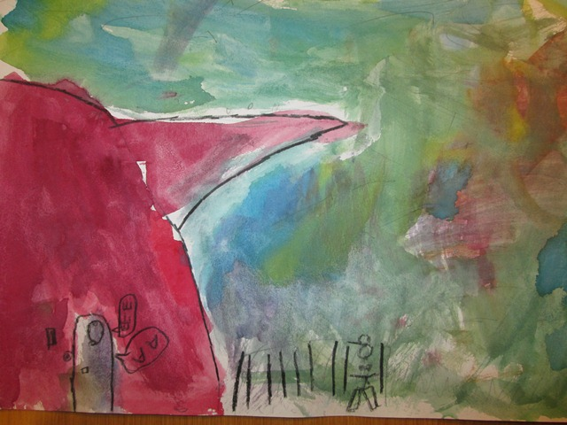
There once was a man who was walking past the sea cliffs in the morning. He came to a cave entrance. He heard noises of merriment in the cave. He went into the cave and saw many sealskins lying on the floor.

Slide 3
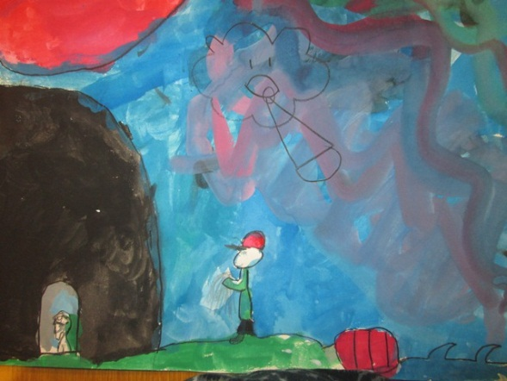
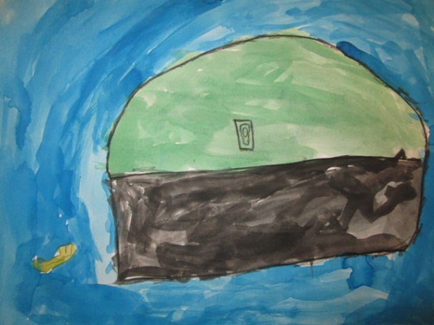
He took one of the sealskins, carried it home and locked it in a trunk.

Slide 4
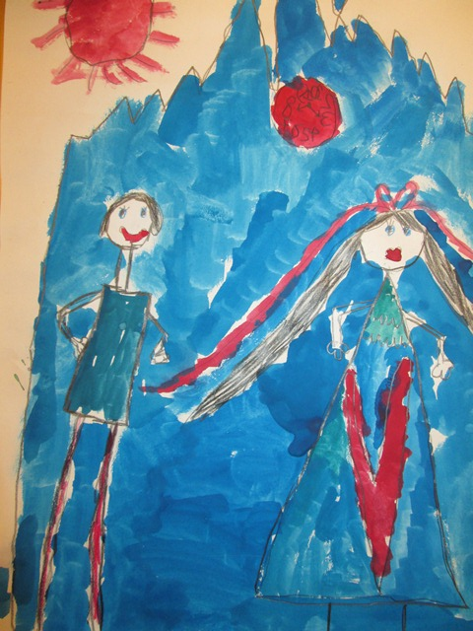
A few days later he returned to the cave. There he saw a youthful and pretty woman. She was naked and crying hard. It was the seal, whose skin the man had taken. The man gave her some clothes and took her home to his house. She was devoted to him, but didn‘t interact with others. Yet she often sat still and looked out at the sea.

Slide 5
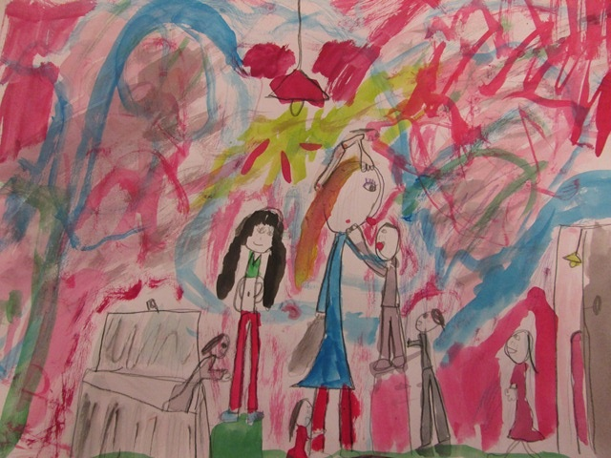
After a while they got married, had a good relationship and had some children. The sealskin was always locked in the trunk and the man carried the key in his pocket wherever he went.
Many years later he went fishing and forgot the key under his pillow at home. Others say that the man had gone with his household to church at Christmas but his wife had been ill and was unable to go with him. The man had forgotten to take the key out of his everyday clothes and his wife found it. When he came back, the trunk was open and the woman and the sealskin were gone.

Slide 6
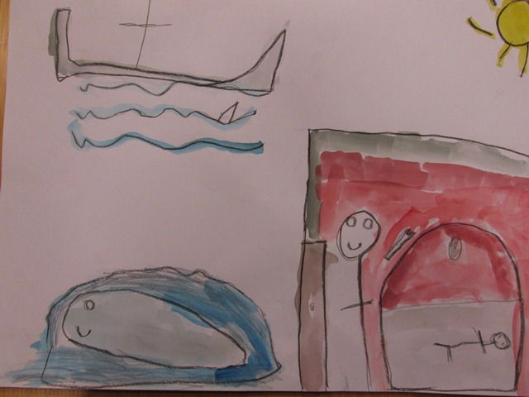
She had taken the key and opened the trunk out of curiosity and there she found the sealskin. She wasn´t able to resist the temptation, said farewell to her children, dressed in the sealskin and jumped into the sea. Before the woman jumped into the sea, she is to have said:
“I am torn,
I have seven children in the sea
and seven children on land.”

Slide 7
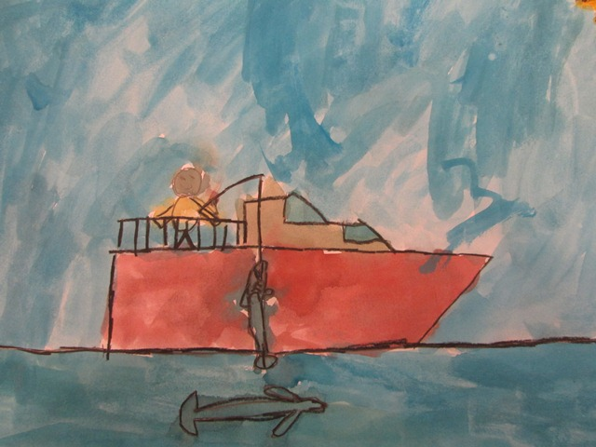
The story goes that the man was truly saddened by the events. But whenever he went fishing afterwards, a seal used to swim around his boat and looked like it had tears in its eyes. The man became really fortunate both with his fishing and his life.

Slide 8
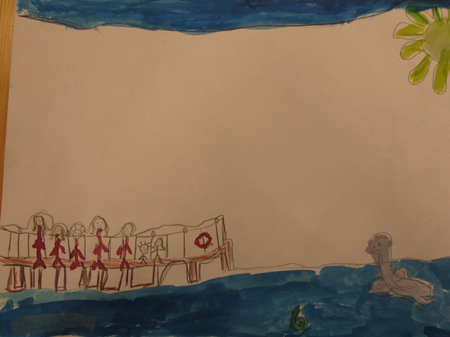
People often saw that when the couples’ children were walking by the shore, a seal swam in the sea near them and threw coloured fish and beautiful shells on land for them. But their mother never came back on land.

